Slide 1
V3D1
WEEK 2b
Textures

Slide 2
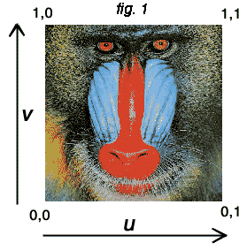

Textures
Texture is a picture that is mapped on an object
Texture pixels are called texels
Width and height in texels have to be power of 2
Textures have (u,v) coordinates that run from 0 to 1 both horizontally and vertically
  Also for non-square textures
v
1
(0,0)
1
u

Slide 3
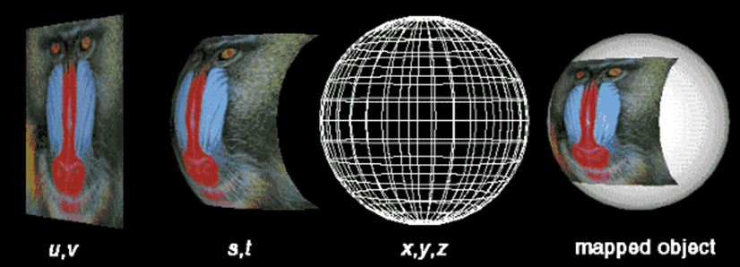
Texture mapping (1)
Objects are made of polygons
For every polygon vertex, (s,t) coordinates are defined, which relate to the (u,v) coordinates of the texture
  Mostly no difference is made between (s,t) and (u,v)

Slide 4
Texture mapping (2)
Example:
  Suppose a model, divided in 10 quads all around
  On every quad, a 0.1 by 0.1 piece of the texture is mapped
0.6
0.5
0.5
0.6

Slide 5
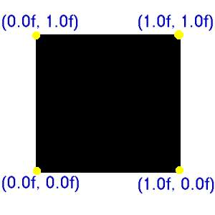
Defining texture coordinates in Vizard
viz.startLayer(viz.QUADS);
viz.texCoord(0.0, 0.0);
viz.vertex(0.0, 0.0, 0.0);
viz.texCoord(1.0, 0.0);
viz.vertex(10.0, 0.0, 0.0);
viz.texCoord(1.0, 1.0);
viz.vertex(10.0, 10.0, 0.0);
viz.texCoord(0.0, 1.0);
viz.vertex(0.0, 10.0, 0.0);
quad = viz.endLayer();
pic = viz.addTexture('a.jpg')
quad.texture(pic)

Slide 6
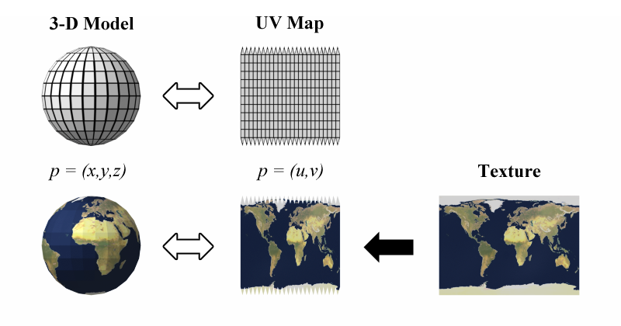
Texture mapping on a sphere

Slide 7
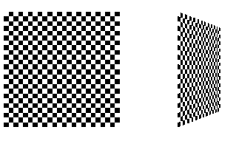
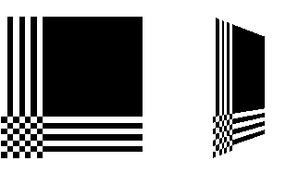
Texture wrapping
What to do if the (s,t) coordinates on the model are outside of the range [0..1]?
  viz.WRAP_S
  viz.WRAP_T
Texture can be repeated, clamped or mirrored
Use like:
  texture.wrap(viz.WRAP_S,viz.REPEAT)

Slide 8
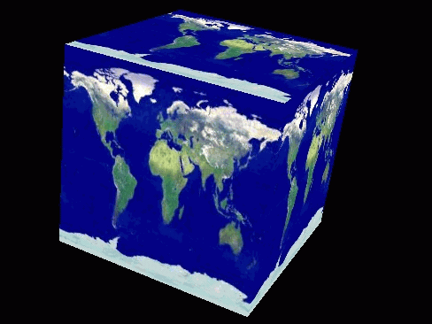
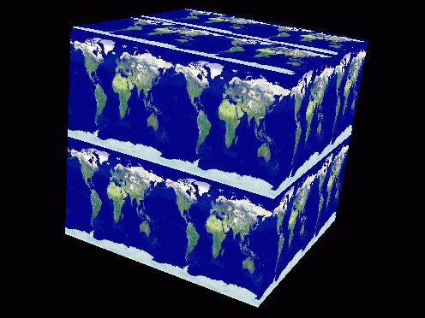
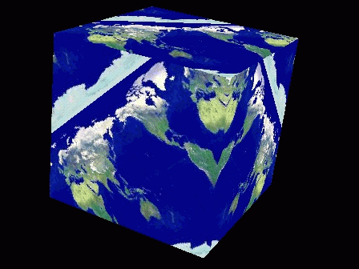
Texture Matrix
A texture can be transformed with the Texture Matrix
  scaling, translation, rotation
(s,t) coordinates (on the object) are multiplied with the texture matrix to get (u,v) coordinates (in the texture)
Examples:
No transform scale factor 2 rotation 45°

Slide 9
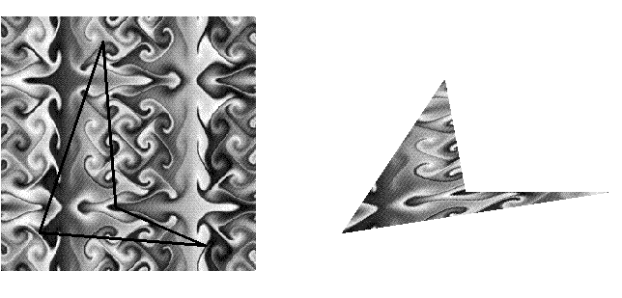
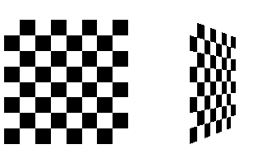
Texture distortion
A texture is distorted in 2 ways:
  Mapping distortion
    When a texture area is
    mapped on a polygon, it
    might be distorted to
    make it fit
  Perspective distortion
    When the polygon is
    shown on the screen, its
    texture is distorted
    because of the
    perspective mapping

Slide 10
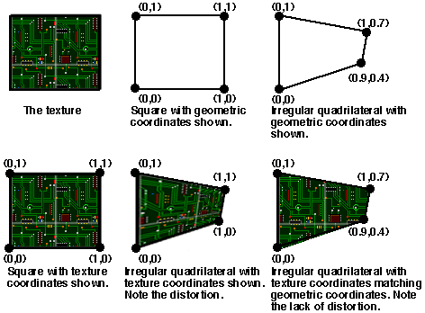
Mapping distortion
Texture coordinates are linearly interpolated between vertices (just like the colors we saw before)

Slide 11
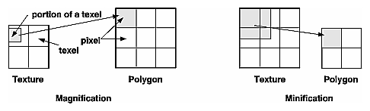
Texture filtering
Texture pixels (texels) have to be mapped on screen pixels (fragments)
  Magnification means that the area of the fragment in texture space is smaller than a texel
    viz.MAG_FILTER
  Minification means that the area of the fragment in texture space is larger than a texel
    viz.MIN_FILTER

Slide 12
Texture filtering
For Minification and Magnification we can use:
  Nearest neighbor (viz.NEAREST):
    Uses the texel closest to the pixel center
    Suffers from aliasing and shimmering
  Bilinear (viz.LINEAR):
    Uses the 4 texels nearest to the pixel center, and takes the weighted average according to distance

Slide 13

Texture filtering
Example using LINEAR:
  Normal Minified Magnified
For Minification there are some extra options which involve mipmapping → covered in other lecture
Texture filtering is defined with method filter:
  texture.filter(viz.MIN_FILTER,viz.NEAREST)

Slide 14
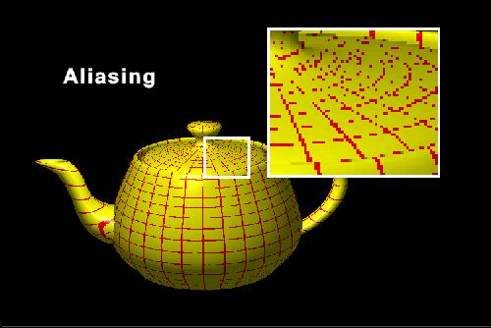
Aliasing
Minification with NEAREST filtering can suffer from aliasing: texels appear to be missing

Slide 15


Blocking
Magnification with NEAREST filtering will suffer from blocking: texels appear as visible blocks

Slide 16
Texture mode
How to combine the original (untextured) color of an object with the texture?
  viz.TEXDECAL: texture replaces the original color, taking into account the transparency of texture pixels
  viz.TEXREPLACE: texture replaces the original color
  viz.TEXMODULATE: mixes original color and texture
  viz.TEXBLEND: mixes texture with a specified color (the blend color)
Texture mode can be set to one of these values (object.appearance)

Slide 17
Formulas
    Mode Result color Result transparency
    REPLACE T_{rgb} T_{a}
    DECAL S_{rgb}*(1-T_{a})+T_{rgb}*T_{a} S_{a}
    MOD S_{rgb}*T_{rgb} S_{a}*T_{a}
    BLEND S_{rgb}*(1-T_{rgb})+B_{rgb}*T_{rgb} S_{a}*T_{a}
  S_{rgb} is the color of the shape being texture mapped
  S_{a} is the alpha of the shape being texture mapped
  T_{rgb} is the texture pixel color
  T_{a} is the texture pixel alpha
  B_{rgb} is the shape blend color
  B_{a} is the shape blend alpha

Slide 18
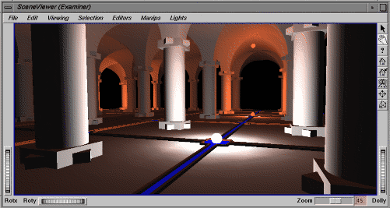
Example
Suppose we have this untextured scene

Slide 19
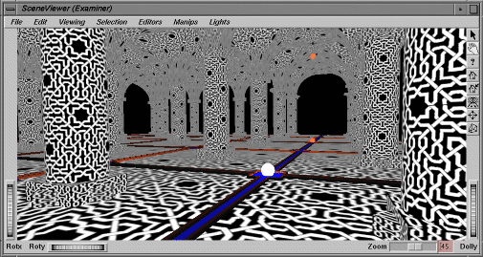
REPLACE

Slide 20
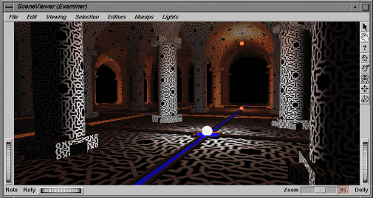
MODULATE

Slide 21
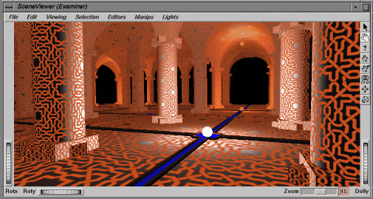
BLEND

